Slide 1
Emotions 1 The Touch Exercise
Bruce Anderson
Ursula Ivonoffski
Desire Guy Hypnosis

Slide 2
Agenda
Anderson Model
Outline
Choose Touch
Break 1 – Touch
Break 2 – Stop
Break 3 – Imagine

Slide 3
The Anderson Model
Emotions as we know them are not real
Sensations are real
Sensations can be changed at will
Emotions, as abstract concepts, cannot

Slide 4
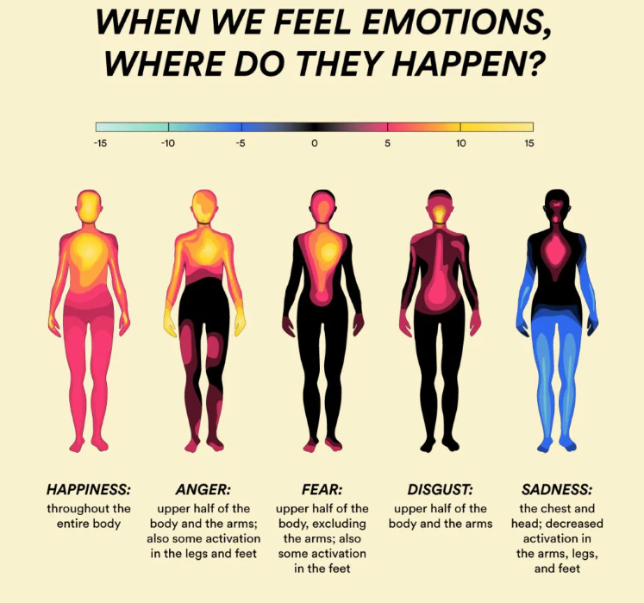
Sensations
Location
Size
Shape
Weight
Colour
Temperature
Boundary
Movement

Slide 5
What’s Coming
During the breakouts, each of you will do the touch exercise. You’ll decide what touch to use soon.
This is NOT a hypnotic event.
Your ‘helper’ will help you by guiding you through the steps and helping you with your awareness of your sensations.

Slide 6
Language To Use
Assume that all sensations have a location.
“Where is that sensation the most intense?”
Assume that other characteristics might not be there
“If that sensation had a <colour>, what <colour> would it be?”

Slide 7
Choosing a touch
The touch should be slow and light
Best if it’s somewhere that your ‘guide’ can see
It should be positive
My favourite is to stroke one of my palms with the tip of the other hand’s index finger
Many other touches will work just as well
Choose one now so you don’t waste time in breakout

Slide 8
Breakout 1 cheat sheet - 10 mins
Do your touch for about 30 seconds
Focus on the direct sensations AND the ‘response’ sensations
Stop touching
What sensations did you experience
Location, size, shape, weight, colour, temperature, boundary, movement
Did they evolve?
<guide help elicit them>
Repeat until time is up

Slide 9
Step 2
The next step is to verify that the sensations linger AFTER the stimulus is removed
This is a critical step. Keep going until you are clear about feeling the sensations AFTER, especially the response sensations.

Slide 10
Breakout 2 cheat sheet – 6 min
Stroke for 30 seconds
Feel the direct and indirect sensations & compare
Stop
Notice how the direct and indirect sensations fade
Describe this to your guide
Repeat for 3 minutes

Slide 11
Imagination
This is the part that tends to blow people’s minds
The objective is to create THE SAME SENSATIONS by imagining the touch
The exercise will be to keep imagining the touch until you begin to experience the sensations

Slide 12
Breakout 3 cheat sheet – 18 min
Do the touch – 30 seconds
Notice sensations – quality and strength
Stop touching. Notice the sensations and how they fade
IMAGINE the touch. Expect the sensations, want the sensations, MAKE the sensations
Keep repeating the cycle until you get them
Each cycle should take about 90 seconds, excluding feedback

Slide 13
This week was all about mind connecting with body
Next week, we find out why the Anderson Model exists and some of what you can accomplish using it.

